Slide 1
G.K.BHARAD INSTITUTE OF ENGINEERING Division:D Subject:CALCULUS Subject code:2110014 TOPIC :- MAXIMA AND MINIMA Group member: Guided by : KARTAVYA PARMAR (67) YAGNIK SIR SHAILESH KHANDAR (26) SHABBIR TATARIYA (02) RAJAN DANGAR (65) SAGAR MOVALIYA (61)

Slide 2
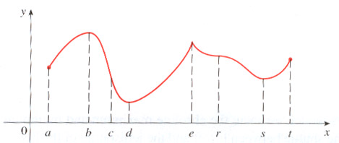
Contain
Maxima & Minima
Maximum value & Minimum value
Saddle point
Local Maximum
Local Maximum
Local Minimum
Local Minimum

Slide 3
WORKING RULES OF MAXIMA AND MINIMA
find
Solve
&
Solve simultaneously equation & find x and y
&
find
Sufficient condition for maxima or minima value rt-s² >0
1.If r>0, t>0 the maxima
2.If r<0, t<0 the minima
rt-s²<0 saddle point then there are no maxima and say that this at point
rt-s²=0 & r=0 nothing can be said about maxima and minima

Slide 4
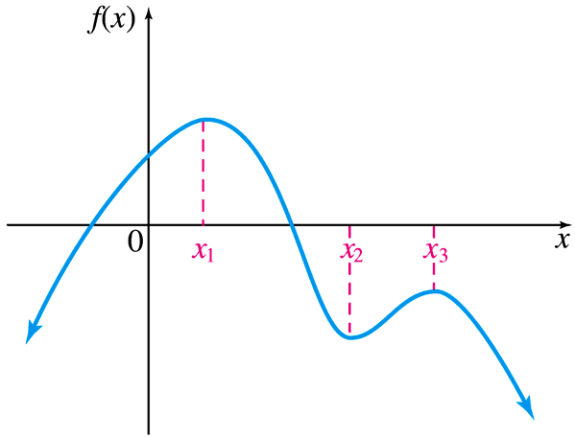
Maximum/Minimum
Maxima
Minim
The max/min occurs at the x-value, but the actual max/min is the y-value

Slide 5
Maximum and Minimum
Let
be a function
If
and
for all small values of
The point a is called the point of maximum of the function f(x).
In the figure, y = f(x) has maximum values at Q and S.
If
and
for all small values of
The point b is called the point of minimum of the function f(x).
In the figure, y = f(x) has minimum values at R and T.

Slide 6
SADDLE POINT
The points at which f (x) or at which f (x) does not exist are called critical points.
A point of extreme must be one of the critical points, however, there may exist a critical point, which is not a point of extreme.

Slide 7
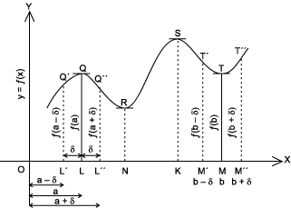
Maximum and Minimum

Slide 8
Example
Find the absolute extrema, if they exist, for the function f(x) = 3x⁴ – 4x³ – 12x² + 2
f’(x) = 12x³ – 12x² – 24x
0 = 12(x² – x – 2)
0 = 12x(x + 1)(x – 2)
x = 0, -1, 2
There are no values where f’(x) does not exist, so evaluate the critical numbers.

Slide 9
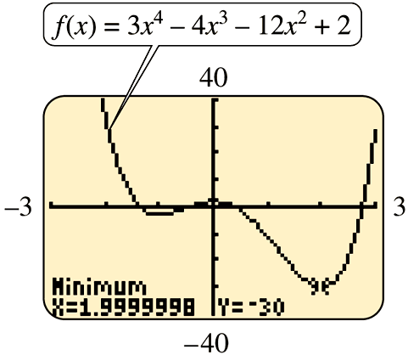
Example Contain
f(-1) = -3
f(0) = 2
f(2) = -30
This is an open interval so we cannot evaluate the endpoints. Instead we evaluate the limit of the function f(x) = 3x⁴ – 4x³ – 12x² + 2 as x becomes increasingly large (x→∞).
Since the function grows without bound, the absolute min of -30 occurs at x = 2. Graphing proves this.
Absolute Min

Slide 10
Find the maxima minima and saddle points of the function
f(x, y) = x²-2xy+2y²-2x+2y+1
&
&
x-2y-1=0
x-y-1=0
+ +
-y=0
Y=0
X=1
so the point is (x , y)=(1, 0)
2. r_{(1,0)}=2 s_{(1,0)} t_{(1,0)}=4
rt -s²
= (2)(4)-(-2)2
=4>0
rt- s²>0 s>o , t>0
(1, 0) is minima
Minimum value at (1,0) point=0

Slide 11
Thank you for giving your attention

